Slide 1
Project: Smart Music Composer
Team 4
Team member:
Junxi Fan, Kaixin Gao, Zhixin Wang
Northeastern University, csye7200-2017-Fall, Instructor: Robin Hillyard

Slide 2
01
Brief Project Recap
02
Generate by Markov Chain
CONTENT
03
Code Explain
04
Demo

Slide 3
1
PART ONE
Project Recap

Slide 4
PROJECT HIGHLIGHTS
Project
Idea
Use
Case
Methodology
Data Source
Our project’s main idea is to develop a program that could read music data and compose new music according to what its read.
User of this program could import .ly format music and program will analysis those music and form new .ly format document.
· Spark Streaming
· RDD to store data
· Algorithm: Markov Chain, Genetic Algorithm
· Tool: Spark, Mllib
www.midiworld.com, freemidi.org
& We processed about 6000 minutes of music.

Slide 5
TEAM EXECUTION
01
02
Collect more than 200 midi songs and starting convert to .ly format for later use.
Implement and revise Scala function, meanwhile looking for references.
Start from reading .ly file.
Week
1
Week
2
03
Week
3
Week
4
04
Continue implement function.
Dec. 2 , completed our first song.
debug project by testing
After Dec. 9, final check and prepare exam and presentation.

Slide 6
2
PART TWO
Generate by Markov Chain

Slide 7
Why Markov Chain?
MC is memoryless
one can make predictions for the future of the process based solely on its present state. This character called “memorylessness” is important when we try to get a random element based on a “state space”.
State Space
Because we cannot fabiricate music base on nothing, we need many music source to form a “music library”. After that, using mc to generate music is well-grounded.

Slide 8

How it works
Shapeless
A type class and dependent type based generic programming library for Scala. According to this, we can deal with different types of data.
Build a“dictionary”
We generate this two type.
Type Relate is the type of element we use to predict what is next. In it, Sized is a Wrapper for a collection type witnessing that it has the statically specified length; Nat is Base trait for type level natural numbers,
so we can decide how many elements in the initial data are in a type Relate
Notes:
We generate this two type.
Type Relate is the type of element we use to predict what is next.
Here, Sized is a Wrapper for a collection type witnessing that it has the statically specified length.
Nat is Base trait for type level natural numbers,
so we can decide how many elements in the initial data are in a type Relate
Type Dict is a Map of type Relate and its follower.

Slide 9



How it works
Random Generation
Then, we need a method to get random number for generate a MC.
Form MC Stream
Stream is suitable for a unknown length collection. We choose elements in dictionary randomly, and we can decide how many elements in initial data is used for prediction.
Notes:
We generate this two type.
Type Relate is the type of element we use to predict what is next.
Here, Sized is a Wrapper for a collection type witnessing that it has the statically specified length.
Nat is Base trait for type level natural numbers,
so we can decide how many elements in the initial data are in a type Relate
Type Dict is a Map of type Relate and its follower.

Slide 10
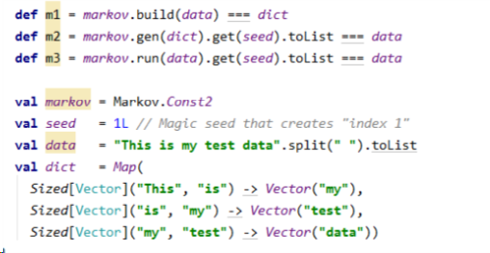
Unit Test
In MarkovSpec.scala, we test every function in Markov.scala. Input an assigned string and then run these functions, if the results are Consistent with the expectation, then these functions are correct.

Slide 11
3
PART THREE
Code Explain

Slide 12
1st Step:
Segment the Ly file into several operable parts
After our analysis on Ly files, we found that different Ly files share some common sections, and they are serialized by fixed patterns.
Common Part 1
Tempo A
Common Part 2
Tempo B
Common Part 3
Tempo C
Common Part 4
Tempo D
Common Part 5
Tempo E

Slide 13
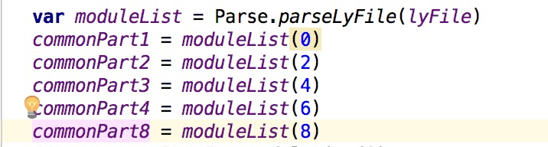
2nd Step:
Get common parts from one single Ly file
1
Read File
2
Store 5 common parts in format of String
By the way, Parse is nothing but a function that we pre-defined to segment Lyfiles.

Slide 14
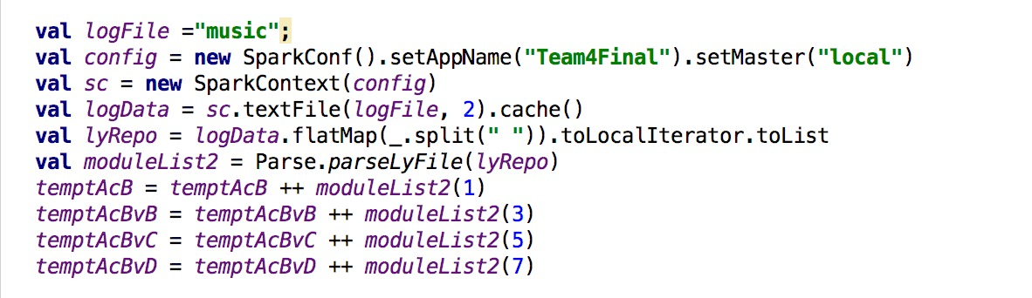
3rd Step:
Get various tempos from given files
Using Spark to get 100 sample Ly files and Converting them into 4 sections

Slide 15
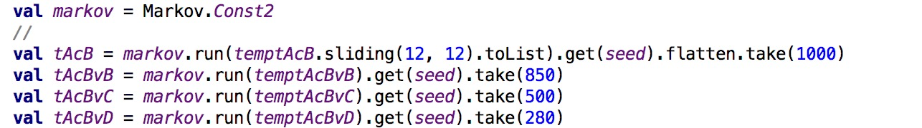
4th Step
Using exist music date collection to get a NEW piece of music section.
Implementing Markov Chain to generate music sections by using lots of sample music.
tAcB is generated by 100 first flexible music sections extracted from Lyfiles, the same as tAcBvB, tAcBvC tAcBvD.

Slide 16
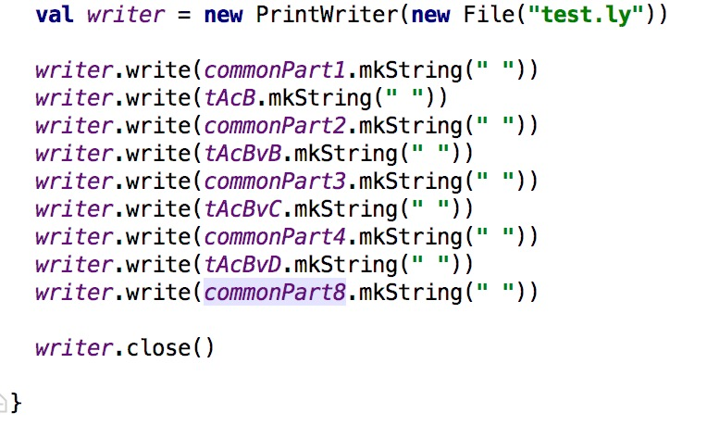
Final Step:
Making these segments into a complete Lyfile.
Using Java IO operation to put these segments together, so the new Song is made of common parts and new-generated music sections.

Slide 17
4
PART FOUR
Demo

Slide 18
Steps
01
02
Prepare Midi Music
03
Can be any kind of music,
For example classic, jazz, pop, or electric(The results may vary). Music document should end with .mid.
Convert To .ly
04
Use LilyPond software to convert from midi to ly, which we can use scala to read, modify and recompose.
Run Program
Run the program, a file will automatically generated.
Check it out !
Check the file we output and test it out.

Slide 19
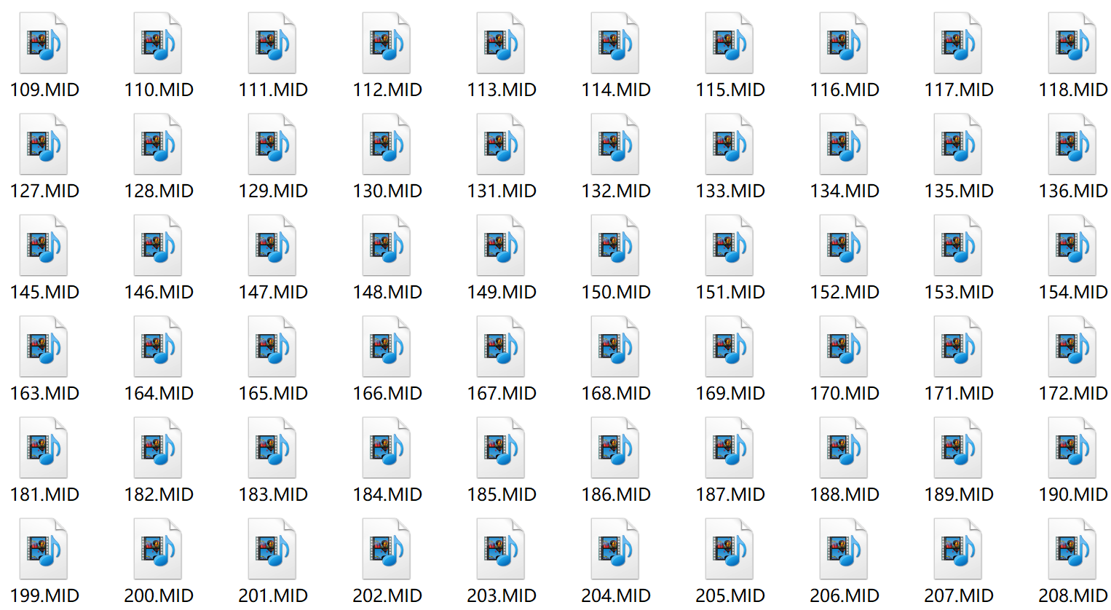

SCREEN SHOTS
Prepare Midi Music

Slide 20
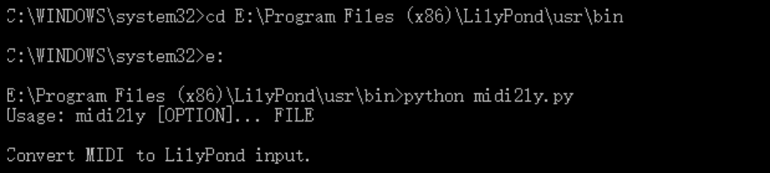

SCREEN SHOTS
Convert To .ly

Slide 21
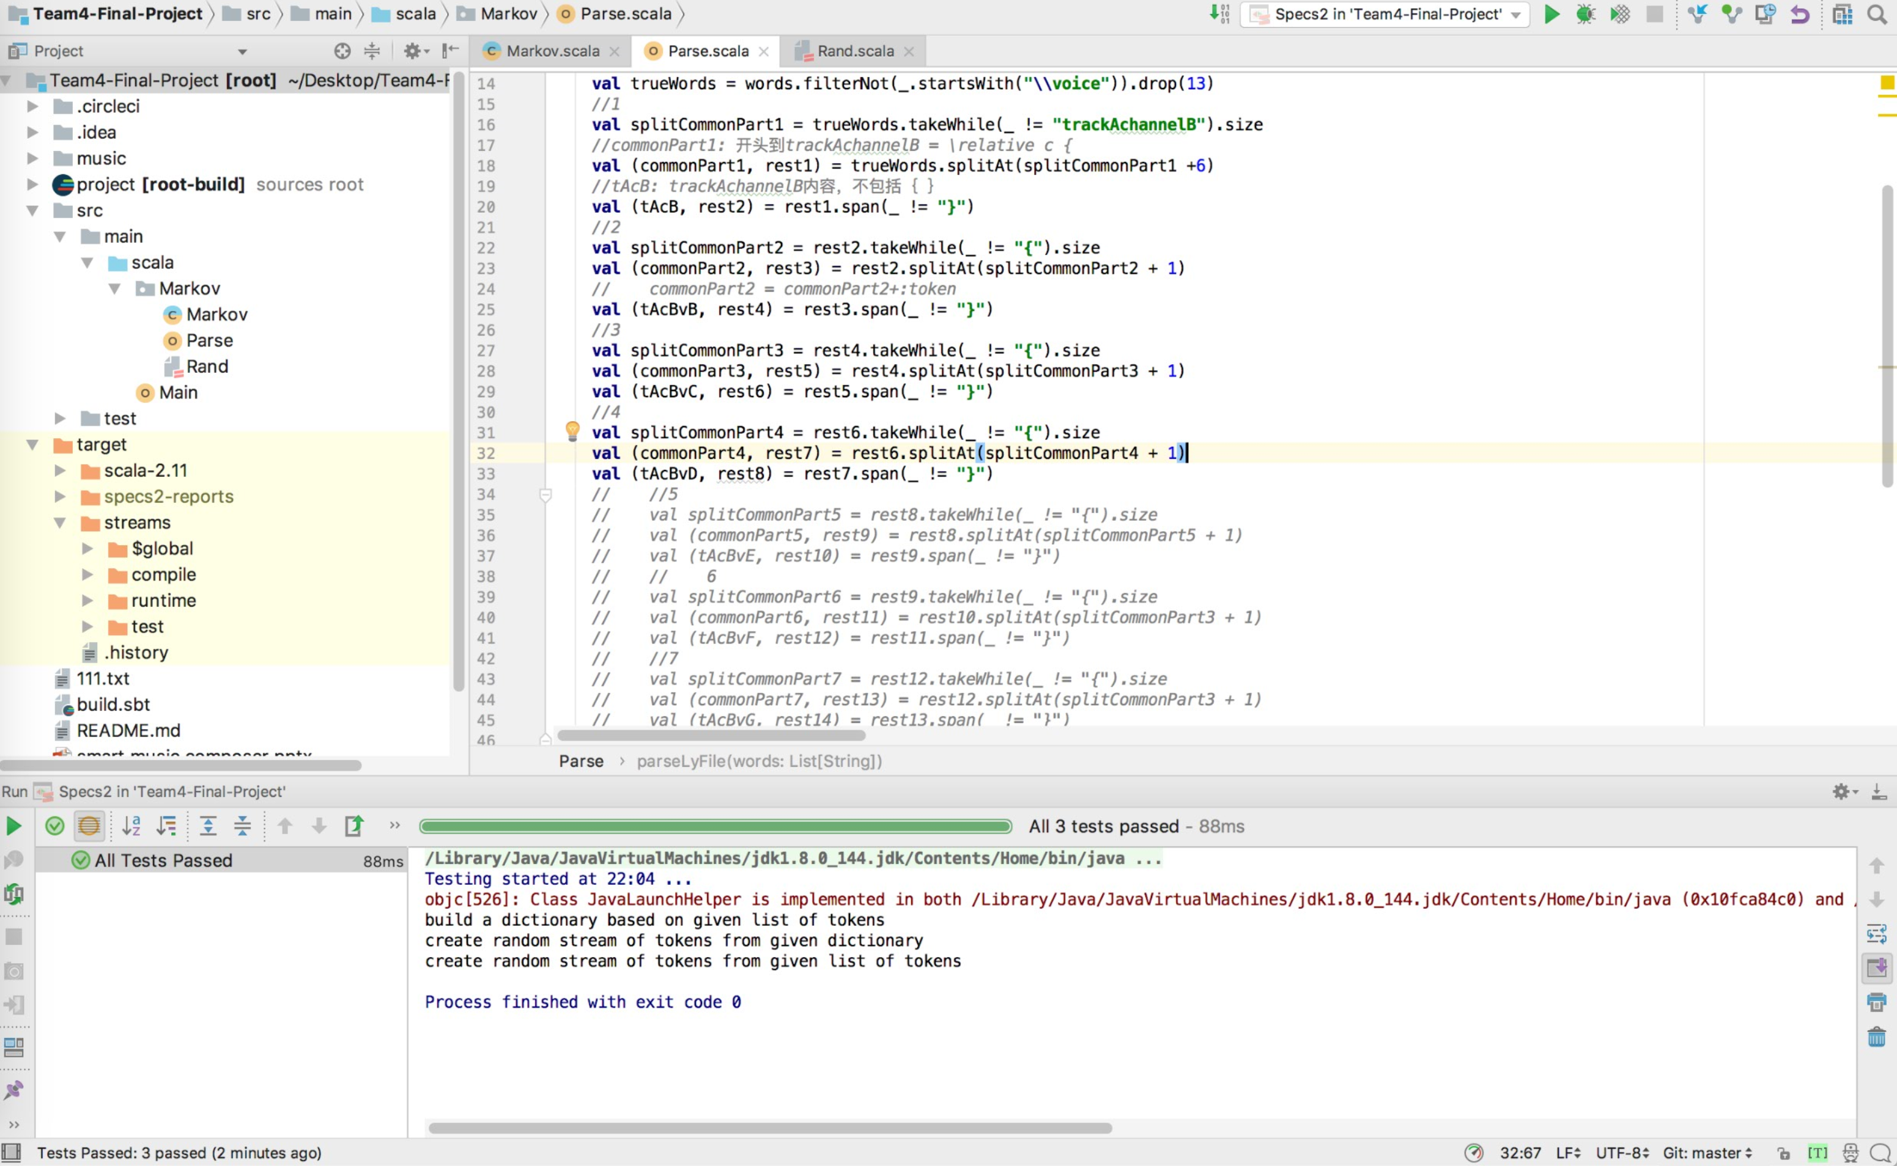

SCREEN SHOTS
Run Program

Slide 22
THANKS FOR YOUR WATCHING

